Slide 1
Project Report

Slide 2
Objective
The objective of this project is to explore, analyze, and derive insights from a dataset consisting of student performance and job details after graduation. The dataset contains various features, including demographic information, academic scores, and job-related information. Our goal is to perform both univariate and bivariate analyses, answer research questions, and derive meaningful conclusions about factors influencing salary and job roles.

Slide 3
Data Description
The dataset contains the following columns:
ID: Unique identifier for each record.
Salary: Salary of the graduate.
DOJ, DOL: Date of Joining and Date of Leaving the job.
Designation: Job title of the graduate.
JobCity: City where the job is located.
Gender: Gender of the graduate.
DOB: Date of Birth of the graduate.
10percentage, 12percentage, collegeGPA: Academic performance in 10th, 12th, and college.
Specialization: Area of study during the graduate's degree.
GraduationYear: Year of graduation.
Various Skills: Scores in English, Logical reasoning, Quantitative aptitude, etc.
Personality Traits: Scores in traits like conscientiousness, agreeableness, etc.

Slide 4
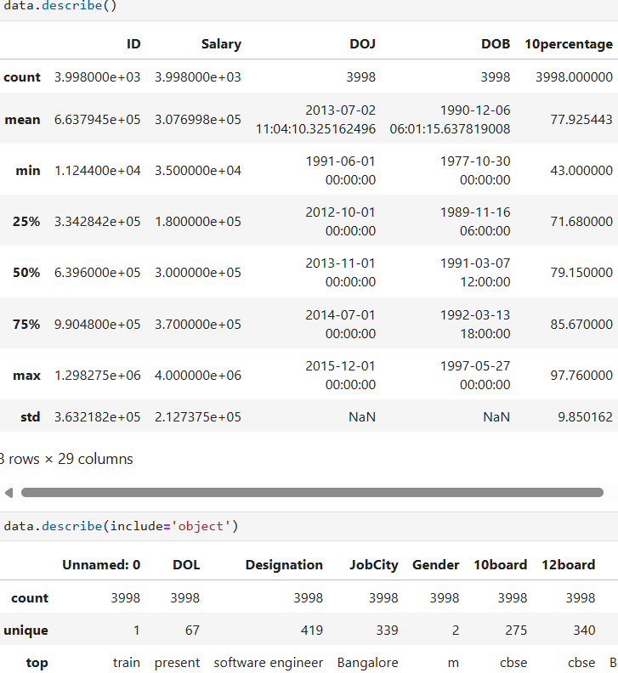
It describes about the data

Slide 5
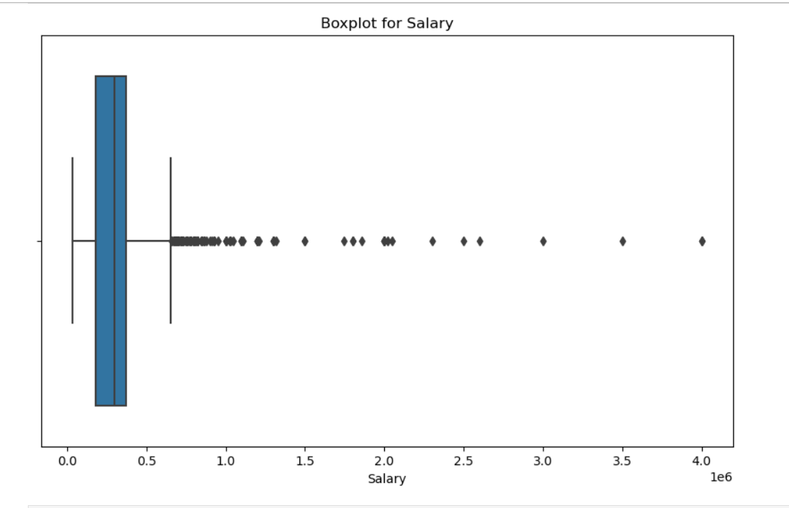
Outlier Detection
We used boxplots to detect outliers in numerical columns like Salary and academic scores. From this box plot we clearly saw that, in salary there are some outliers are present.

Slide 6
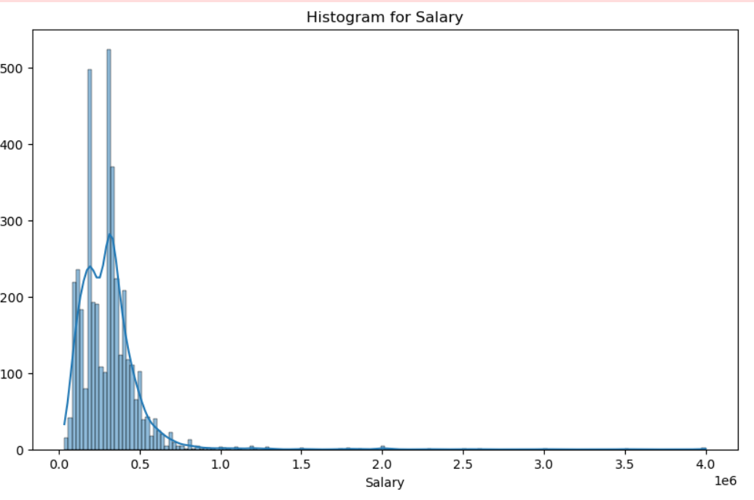
Distribution of Numerical Variables
Histograms were used to visualize the distribution of numerical variables such as Salary, 12th Percentage, and College GPA. The distribution of Salary is right-skewed, indicating most graduates earn less, with a few high earners.

Slide 7
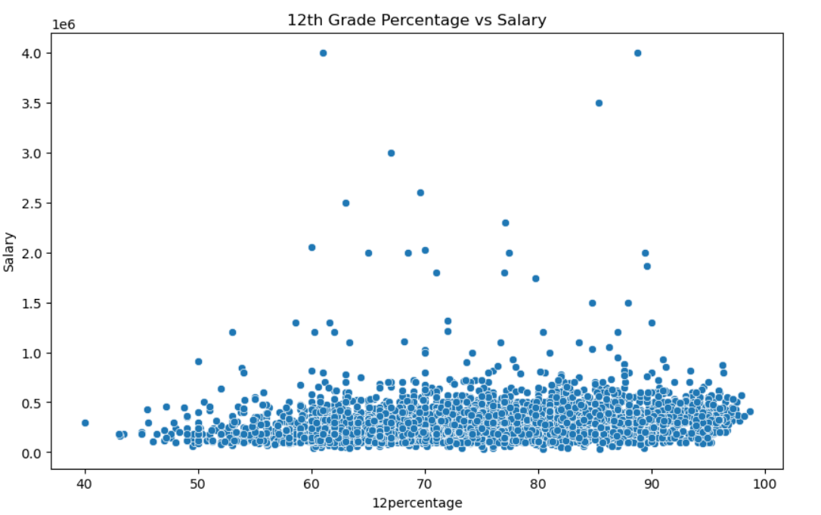
Bivariate Analysis
Scatter Plot:
We explored relationships between numerical variables such as 12th Percentage and Salary. Higher percentages in 12th grade do not necessarily correlate with higher salaries.

Slide 8
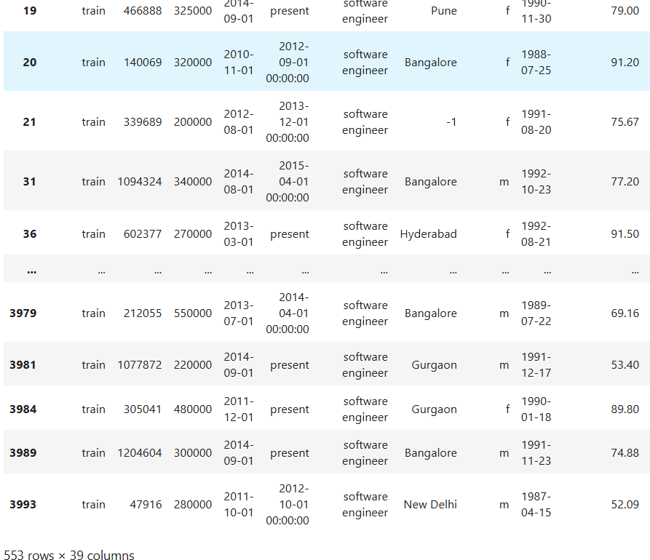
Testing the Salary Claim:
According to an article, fresh graduates in roles such as Software Engineer or Programming Analyst earn between 2.5 to 3 lakhs per year. We tested this claim using the dataset. The average salary for the specified roles is 339792.4 , which support the claim that fresh graduates earn more than 2.5-3 lakhs.

Slide 9
Relationship Between Gender and Specialization:
We used a chi-square test to see if there is a relationship between gender and specialization.
With a p-value of 1.24e-06, we reject the null hypothesis, suggesting that the choice of specialization is influenced by gender.

